Slide 1
Lifestyle Medicine Certificate Course Reviews of course Participants

Slide 2
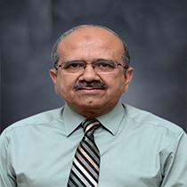
“Attending Lifestyle Medicine Course By Madam Shagufta Feroz Made Me Realise That There Is More To Art Of Healing Then Medicine..…”
Brig (R) Prof Dr. Maqsood-ul-Hassan
MBBS; DPH; MCPS, MSc
Professor of Public Health
Vice Principal (Academics & Coordination)

Slide 3
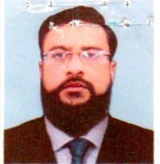
Prof. Dr Omer Awab Khan Professor of Medicine Vice Principal Clinical IIMCT, Railway Hospital
“I learned that if life style modification leads to a body fit for better submission to Allah SWT; It’s a blessing…..”

Slide 4
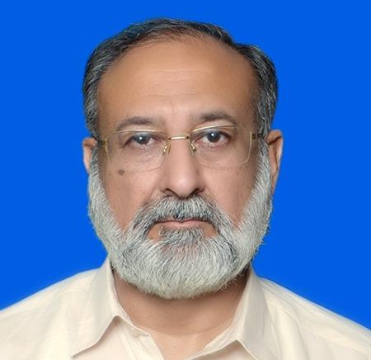
“Learning To Live As Nature Intended Is To Live As Allah Intended…”
Prof. Dr Khalid Farooq Danish
Professor and Head of Department Surgery, IIMC,Riphah International University

Slide 5
“Lifestyle Is Diversification Of Mind, Body And Soul….”
Prof. Dr Fareesa Waqar
MBBS MCPS FCPS MHPE
Head of department obstetrics and Gynaecology
Medical Educationst
Vice President SOGP
TAC member PMRC
Chairperson curriculum committee
Chairperson morbidity mortality committee
Member infection control committee
Supervisor and Examiner MBBS , MS, MCPS, FCPS
More than 60 national and international research publications
Organised and attended many national , international conferences.
Key role in organising all ICMEs held by Riphah university

Slide 6
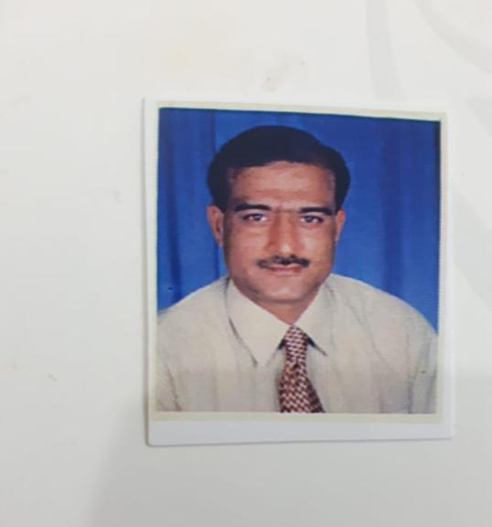
“Come Back To Nature And Be Natural…”
Prof. Dr Muhammad Ayaz Bhatti
MBBS.MPH. MSC. MHPE
HOD Community Medicine,IIMC
Riphah International University

Slide 7
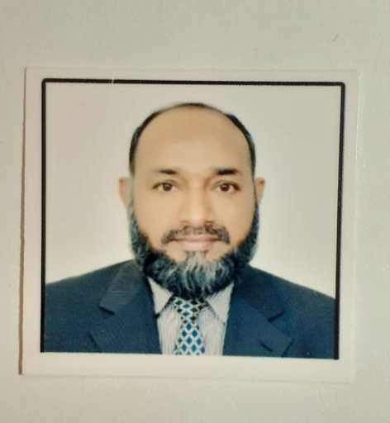
“Life Style Medicine Course Gave Me A Second Life❤️
Dr Shagufta Managed The Sessions In A Way That It Was A Story Which Provoked A Vicious Cycle Of Thirst. It Was An “Afternoon Lori” Which Kept Me Awake & alert Like Never Before🌹…..”
Prof. Dr Muhammad Masood Khokhar,
TI( M) MBBS, FCPS, MCPS, PGDC(Psychiatry)
Medical Educationist and
HOD Psychiatry

Slide 8
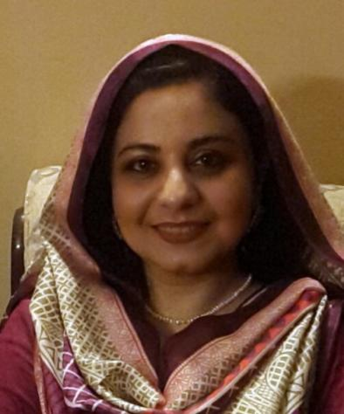
“This Course Was A Life Changing Experience For Me ...I Learned That You Do Not Find A Happy Life You Make It ...And This Course Gives You A Road Map To The Happy Life…..”
Prof. Dr Shazia Ali
Head of Physiology Department,
MBBS, M phill, PhD, PGD, CHPE, CMT
PhD Coordinator
Member of Synopsis Review Committee
Member of Curriculum Implementation Committee

Slide 9
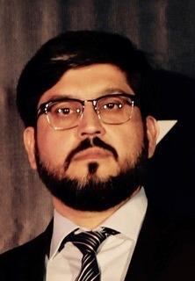
“Our Religion Teaches Us To To Live As The Nature Intends, Which Is Also The Theme Of This Course…"
Prof. Dr. Rehan Ahmed Khan
MBBS, FCPS , FRCS, JM-HPE, MSc HPE, PhD (Scholar) Assistant Dean Medical Education and Professor of Surgery , Chairperson Assessment Committee Islamic International Medical College Riphah International University

Slide 10
Prof. Dr Saadia Sultana MBBS, MCPS, MCPS-HPE Prof of Obstetrics and Gynecology Medical Educationist Associate Editor of JIIMC Member Evaluation committee, ASPIRE, Student Mentor and President IISWA
“Being Positive In Negative Situation Is Sign Of Wisdom And Character…… !!!”

Slide 11
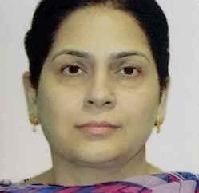
“Lifestyle modification a way forward to a better life…..”
Pof. Dr Humera Fayaz Khan
MBBS, FCPS(Physiology), MHPE
Physiology Department,IIMC
Medical Educationist
Member Assessment Committee

Slide 12
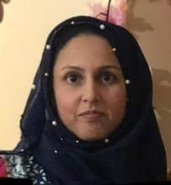
Prof. Dr Madiha Sajjad FCPS (Histopathology), MHPE Professor of Pathology, IIMC
“Think Not Only Of Treating The Disease But The Person Holistically….”

Slide 13
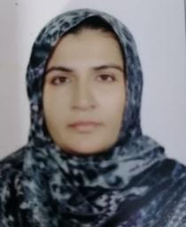
Dr. Fatima Ehsan Associate Professor MBBS, M. Phil, PGD, CHPE Tarbiyah Manager IIDC
“I Learned The Significance Of Biological Rhythm With Mind, Body And Soul Through Simple Life Modifications..…”

Slide 14
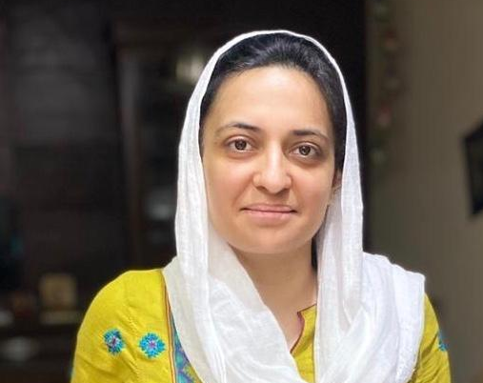
“I Learned A Totally New Neglected Aspect Of Life In This Course. It Realized Me That Without Caring For Ourselves We Cannot Care For Our Family Patients And Country . What I Like The Most About This Course Is Dr Shagufta Feroz. Her Enthusiasm And Love For Lifestyle Medicine Is An Inspiration For Me To Change Myself And Then My Family And Patients And In Turn Contributing To My Country….”
Dr Saba Afzal
(MBBS, FCPS, CHPE)
Assistant professor IIMCT

Slide 15
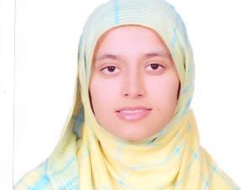
“It Was Not A Certificate Course Only, But A Transformational Experience...!!”
Dr Abeera Zainab
Assistant Professor
Biochemisty, IIDC
Riphah International University

Slide 16
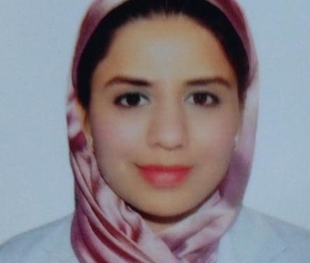
" For Me This Soulful Course Has Been A Journey To Self-Discovery…."
Dr Ammara Ayub
MBBS, FCPS(Paediatrics), CHPE
Senior Registrar Paediatrics IIMCT.

Slide 17
“Science Of Living Is As Simple As….Achieving Homeostasis And Following Circadian Rhythm..”
Dr Muhammad Asad
(MBBS, FCPS)
SENIOR REGISTRAR SURGERY, IIMC, Riphah Inter

Slide 18
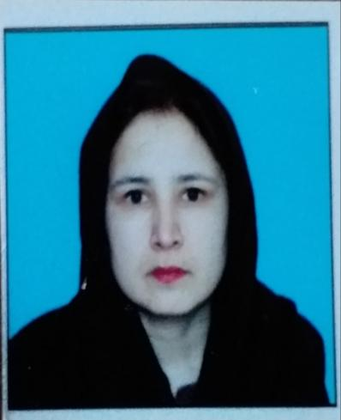
“Always Love Yourself Because No One Can Do This Better Than You….”
Dr Kiran Fatima
MBBS FCPS
Senior Registrar (Medicine) IIMC
Riphah International University

Slide 19
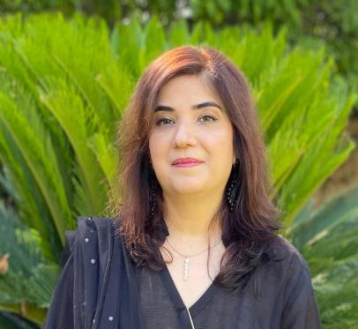
Life Style Medicine Course For Me Is An Eye Opening In All Perspectives. It Has Given Me A Broad View Of
What Actually A “Healthy Life Style” Term Stands For Which Has Always Been A Query To Me.
I Thank Dr Shagufta Feroze For Her Support And Riphah University For Getting Me Through Such An Amazing Life Changing Course.
Mrs. Ummaira Saleem
MSc Foods and Nutrition
Consultant Dietician (Fauji Foundation Hospital)
Consultatn Dietician ( Garrison Medical Centre)
Ex Consultant Dietician PMEH, Rawalpindi
Former Inter in clinical Nutrition( Quaid E Azam International Hospital

Slide 20
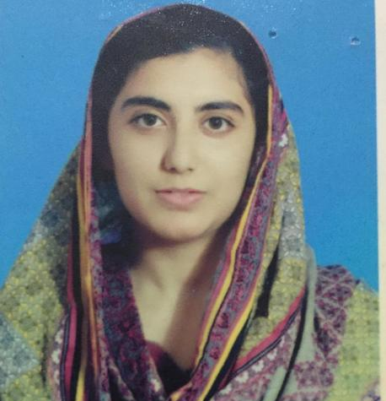
“Lifestyle Medicine Is All About Finding The Cure Within Yourself And Taking The Right Food For The Betterment Of Your Soul And Wellbeing….”
Dr foqia Nasreen
MBBS, Resident paediatrics

Slide 21
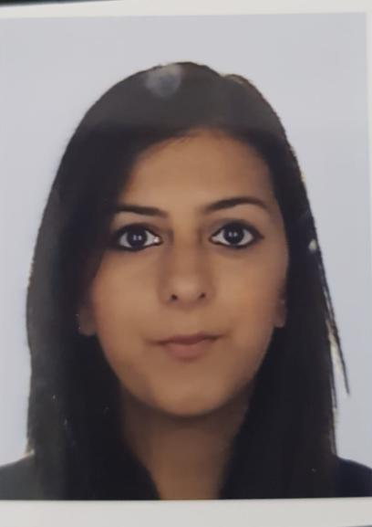
Mrs. Abira Rana Naturopath, Nutritional Therapist Member of American Collage of Lifestyle Medicine
“A Truly Eye Opening And Soul Enriching Course, That Will Help Me To Change Me, My Family And The Larger Community…”

Slide 22
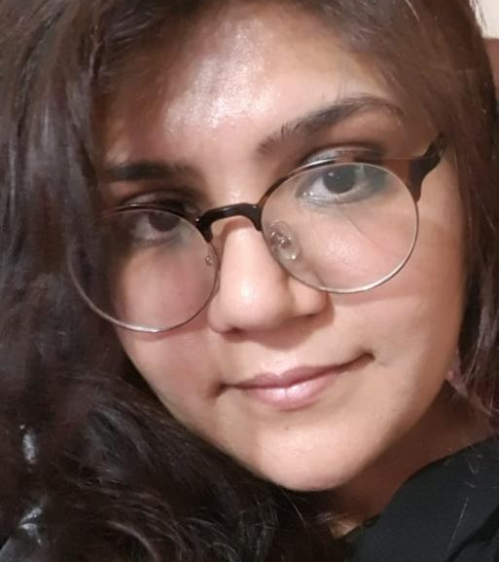
"Self Care Is How You Take Your Power Back… "
Dr Hina Tanveer Demonstrator Pathology, IIDC
Riphah International University

Slide 23
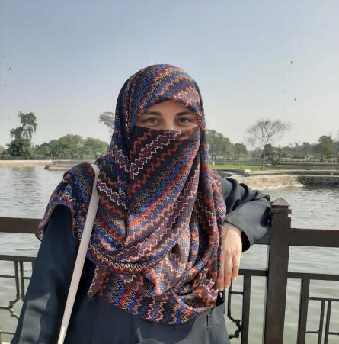
“Amazing Journey Of Self Discovery With
Dr. Shagufta Feroz. Without Self Healing, We Can't Heal A Human Body……”
Dr Saman Khursheed
Graduate of King Edward Medical University 2018
House Job Experience 2019-2020

Slide 24
“The Basic Thing Which I Learned From This Wonderful Course Is That There Is No Wrong In Bringing Any Change In Your Life When You Are Following The Right Path...”
Dr. Huma Tahir
BDS, Mph
Assistant Professor
Community Dentistry Department,
Abbottabad International Dental College

Slide 25
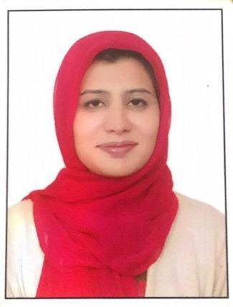
The best thing about this course is undoubtedly meeting and knowing Dr. Shugufta Feroz and this team of ours.
Through this course I am learning the miraculous effects of life style modifications in one’s life.
I found myself more motivated to Chang life style behaviours to take greater control of not only my but the health of my family, friends and people around me.
Dr. Shugufta has literally charged me. Thank you Ma’am for being our inspiration.
Dr. Misbah Malik
BDS, Biochemistry Department
IIDC, Riphah International University

Slide 26
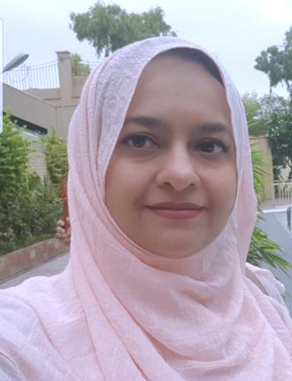
“Lifestyle Is All About Choosing Between Right And Wrong . It’s Never Too Late To Take The First Step Today And Become A Change Agent For Tomorrow….”
Dr Tahira Sadiq
(MBBS, MPH, PGD, MHPE)
Associate Professor, Community Medicine
Tarbiyah Manager, IIMC
Medical Educationist
President Arts and Crafts Society
Program Coordinator Lifestyle Medicine Certificate Course
Member Assessment and Faculty development committee

